Slide 1


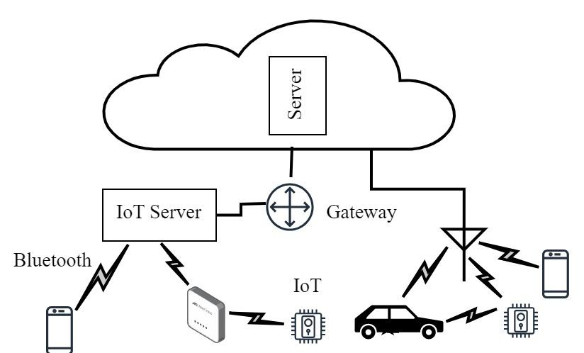
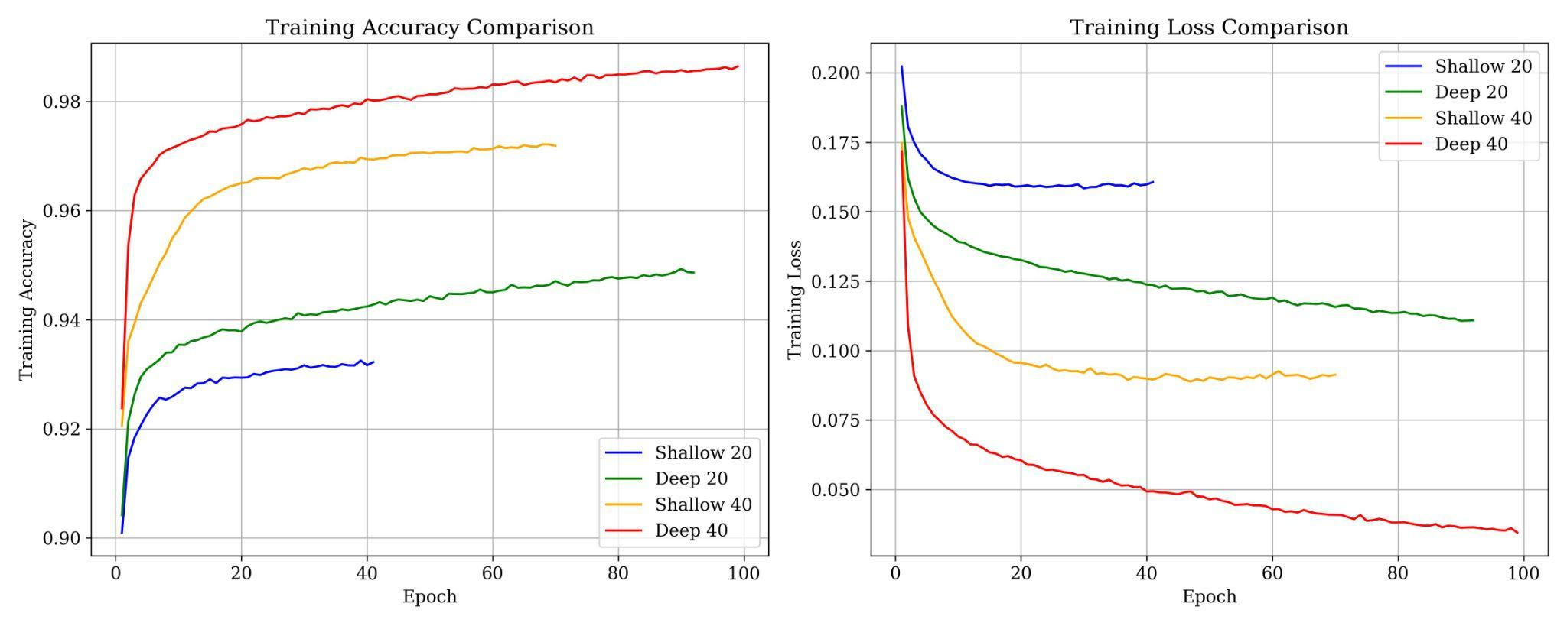
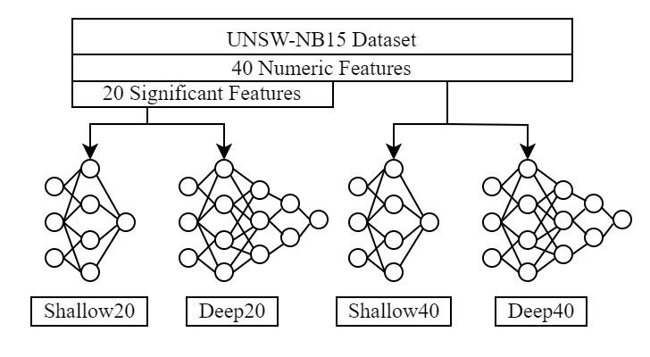
Securing IoT Servers: Shallow vs. Deep Neural Network Architectures
Niranjan W. Meegammana, Shilpa Sayura Foundation, Sri Lanka
Harinda Fernando, Sri Lanka Institute of Information Technology, Sri Lanka
INTRODUCTION
METHODOLOGY
RESULTS
Follow Machine Learning (ML) pipeline .
Balance the UNSW-NB15 dataset using undersampling
Create two datasets with 20 significant features obtained from Pearson Correlation and Information and 40 numeric features.
Splitting: training (90%), validation (5%), and testing (5%).
Shallow model : 1 layer (512 neurons)
Deep model : 7 layers (256, 128, 64, 32, 16, 8, 4 neurons).
Hyperparameter tuning using keras random search.
Validation loss and accuracy change during training
Model performance evaluation
Best hyperparameters of four models
Performance Data | Shallow20 | Deep20 | Shallow40 | Deep40
Training Time (S) | 289 | 902 | 512 | 962
Max. Validation Accuracy | 0.93 | 0.94 | 0.97 | 0.98
End Epoc | 10 | 61 | 39 | 68
Minimum Validation Loss | 0.166 | 0.130 | 0.088 | 0.057
Prediction Time | 0.55 | 0.56 | 0.57 | 0.59
Test Accuracy | 0.93 | 0.94 | 0.97 | 0.98
Precision | 0.94 | 0.96 | 0.97 | 0.98
Recall | 0.92 | 0.92 | 0.97 | 0.98
F1 Score | 0.93 | 0.94 | 0.97 | 0.98
ROC AUC Score | 0.986 | 0.990 | 0.996 | 0.998
Average Precision | 0.987 | 0.991 | 0.996 | 0.998
An IoT Environment
Configuration | Shallow20 | Shallow40 | Deep20 | Deep40
Model Parameters | 11265 | 49313 | 21008 | 54433
Data Inputs | 20 | 40 | 20 | 40
Hidden layers | 1 | 1 | 7 | 7
Neurons per layer | 512 | 512 | 256, 128, 64, 32, 16, 8, 4 | 256, 128, 64, 32, 16, 8, 4
activation_layer1 | Relu | Tanh | tanh | ReLU
activation_layer2 | - | - | tanh | ReLU
activation_layer3 | - | - | ReLU | leaky_relu
activation_layer4 | - | - | ReLU | ReLU
activation_layer4 | - | - | ReLU | ReLU
activation_layer6 | - | - | ReLU | ReLU
activation_layer7 | - | - | leaky_relu | leaky_relu
optimizer | Rmsprop | Adam | Adam | Adam
learning_rate | 0.001 | 0.001 | 0.001 | 0.001
weight_initializer | he_normal | he_normal | he_normal | glorot_uniform
batch_size | 256 | 64 | 8 | 16
Output function | Sigmoid | Sigmoid | Sigmoid | Sigmoid
Application servers in IoT environments face critical challenges from network attacks.
Conventional IDS and firewalls struggle to mitigate these attacks due to the unique network topologies, heterogeneity, and resource limitations of IoT networks.
We investigate the effectiveness of shallow and deep neural network (NN) architectures in detecting attacks on IoT application servers.
OBJECTIVES
Resource Utilization
Develop four shallow and a deep NN models.
Create two datasets with 20 and 40 features.
Train and test four models using two datasets.
Compare and evaluate the performance of four models.
Performance Data | Shallow20 | Deep20 | Shallow40 | Deep40
Model Size (Kb) | 110 | 190 | 648 | 708
Prediction Time (s) | 0.55 | 0.56 | 0.57 | 0.59
CPU Usage % | 0.25 | 0.26 | 0.30 | 0.32
Memory Usage (GB) | 0.016 | 0.017 | 0.019 | 0.021
SOLUTION
CONCLUSION
Creating varied complex NN models.
Deploy them on IoT environments with varying resource levels.
Deep40 model demonstrates superior accuracy (98%) and generalization, with high resource usage (0.32%).
Shallow20 models resource-efficient with reduced accuracy (95% of Deep40), low resource usage (75% of Deep40) suitable for resource-constrained environments.
Presented at
AINTEC 2024 Conference ACM SIGCOMM 2024 UNSW, Sydney Australia
Four Models Trained
REFERENCES
Train four models using supervised learning.
Test model performance and resource utilization.
Compare and evaluate the model performance.
Aggarwal, Charu C. 2023. Neural Networks and Deep Learning. Springer Nature.
Bianchini, Monica, and Franco Scarselli. 2014. “On the Complexity of Neural Network Classifiers: A Comparison between Shallow and Deep Architectures.” IEEE Transactions on Neural Networks and Learning Systems 25 (8): 1553–65. https://doi.org/10.1109/tnnls.2013.2293637.
Chollet, François. 2018. Deep Learning with Python. Shelter Island (New York, Estados Unidos): Manning.
Hapke, Hannes, and Catherine Nelson. 2020. Building Machine Learning Pipelines : Automating Model Life Cycles with Tensorflow. Beijing ; Boston ; Farnham ; Sebastopol ; Tokyo O’reilly.
Moustafa, Nour, Mohamed Abdel-Basset, and Reda Mohamed. 2022. Deep Learning Approaches for Security Threats in IoT Environments. Wiley-IEEE Press.

